Slide 1
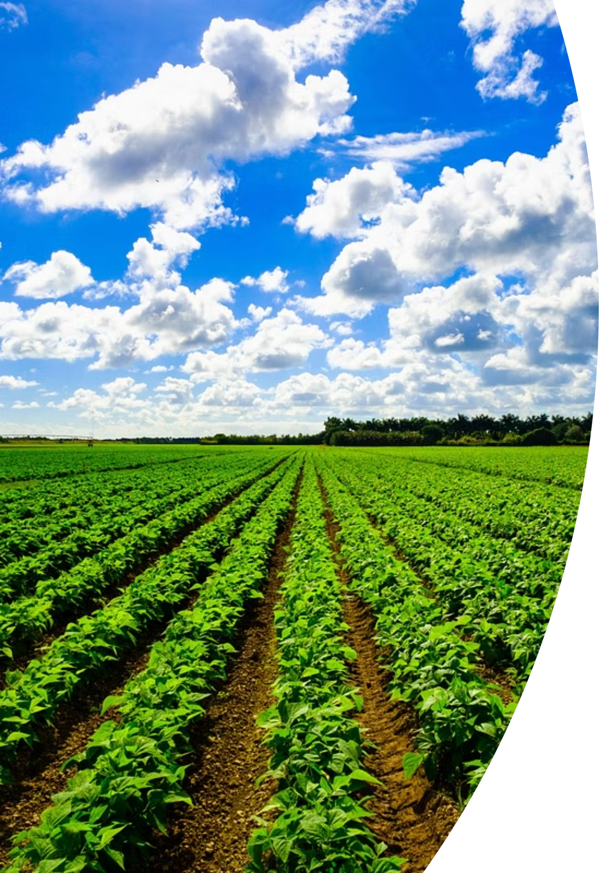
Agriculture Crop Yield Prediction Using Machine Learning
Guide Name : Dr. A. MEENAKSHI, M.S., Ph.D.
DHANUSH S
RA2432241040006
MCA-II YEAR

Slide 2
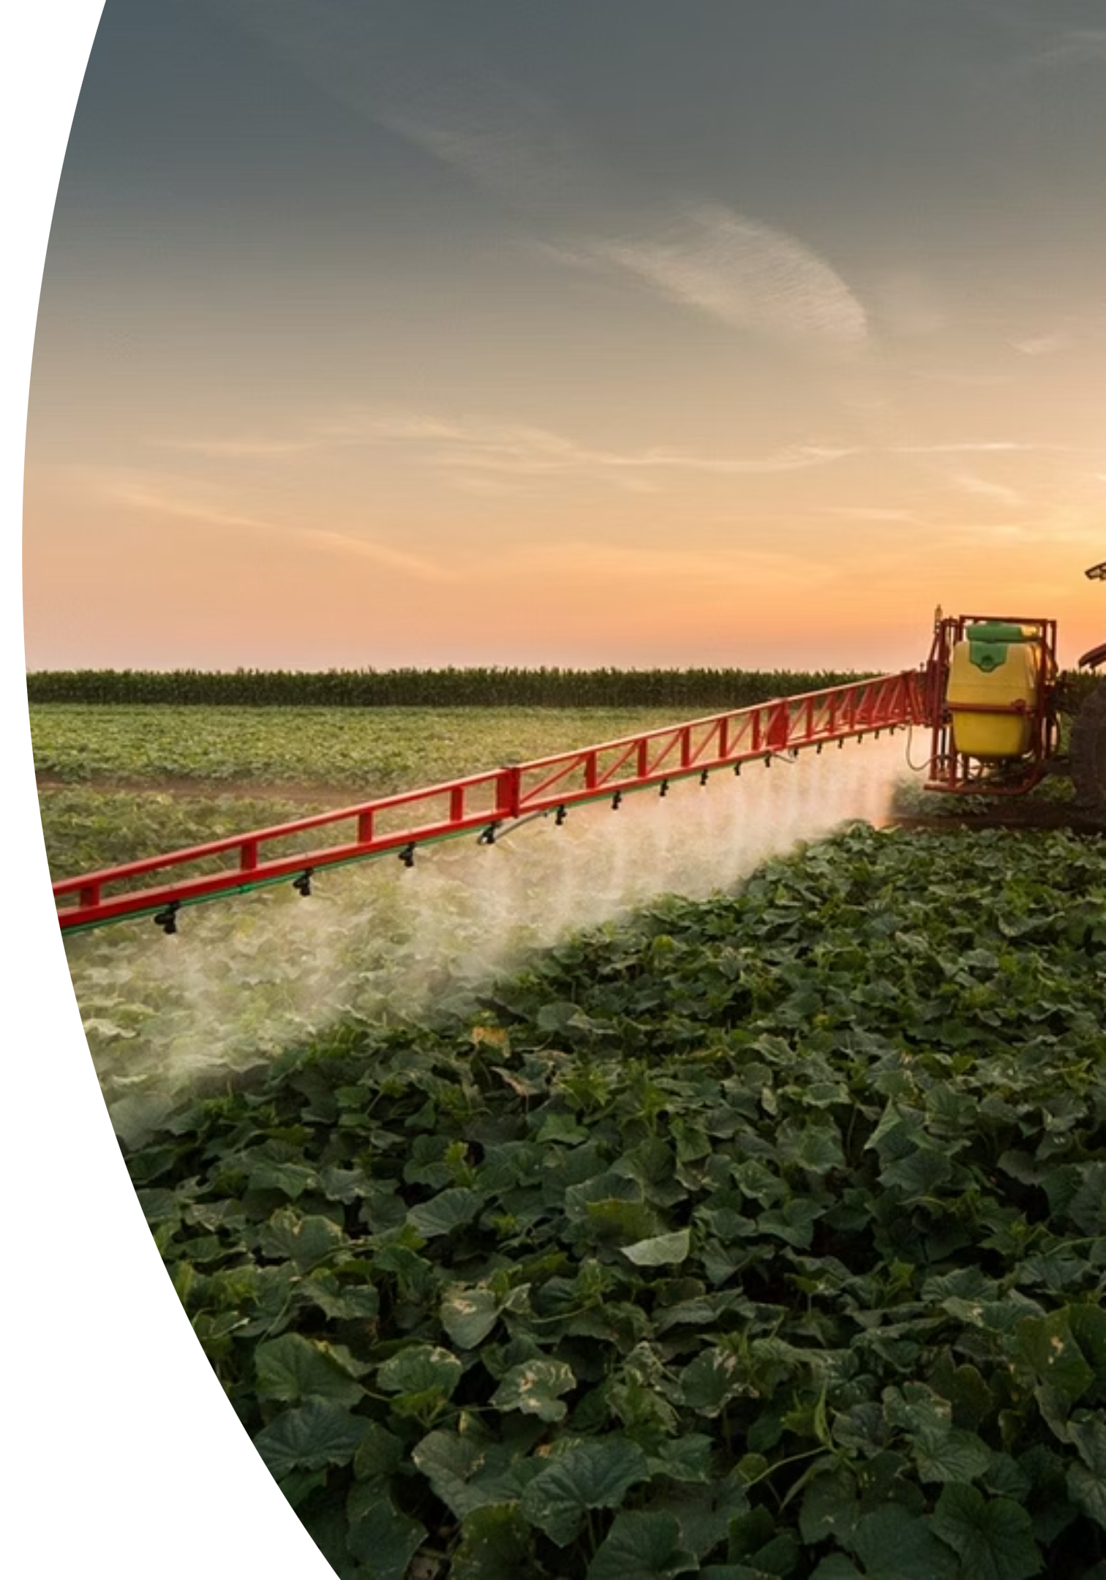
Abstract
Farming is very important for food and the economy, especially in a country like India. Machine learning models were applied using Python in Jupyter Notebook to predict crop yield based on these features. Additionally, a user-friendly web interface was developed to allow farmers and researchers to input data and get yield predictions. Basic data analysis and visualization techniques helped uncover meaningful insights, such as loamy and clay soils producing better yields under proper irrigation and fertilizer use.
In this project, a Multiple Linear Regression algorithm is used to predict crop yield based on various agricultural and environmental factors. The dependent variable in this study is Crop Yield (measured in tons per hectare). The independent variables include Region (North, South, East, West), Soil Type (Clay, Sandy, Loam, etc.), Crop Type (Wheat, Rice, Maize, etc.), Rainfall (in mm), Temperature (in °C), Days Taken to Harvest, Fertilizer Usage, Irrigation Level, and Weather Conditions (Sunny, Rainy, or Cloudy).
We used the Kaggle crop yield dataset to analyze and understand the data. The results show that crops grow better in loamy and clay soils, especially when there is enough water and fertilizer. Good weather conditions like su nlight and average rainfall also help crops grow more. For example, rice needs more water, while wheat grows well in the right temperature. The study found that the highest yield was achieved with loamy soil, proper irrigation, and fertilizer use, along with sunny weather and moderate rainfall. Among all crops, rice and maize gave the best results.
This study helps support smart farming decisions and better food production.

Slide 3
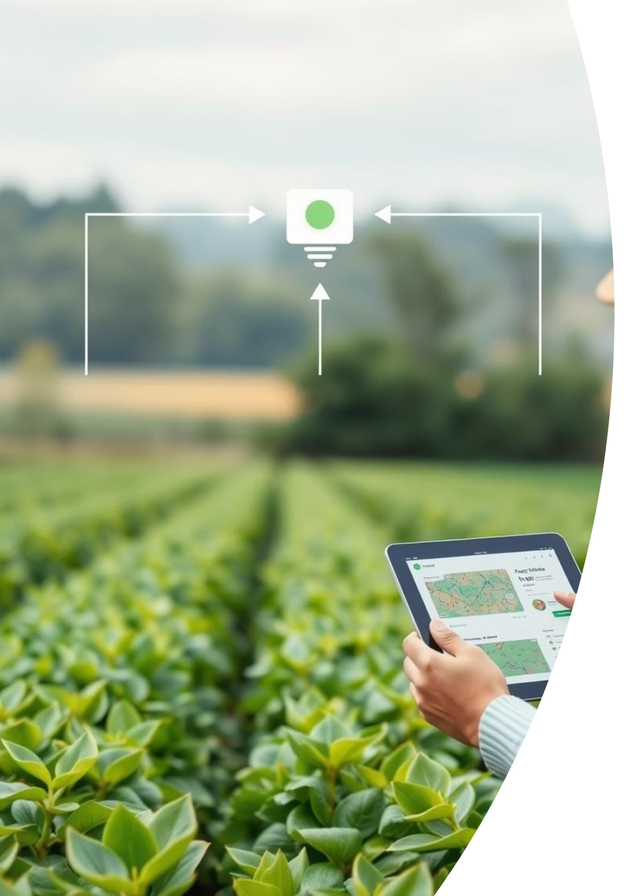
Introduction :
Importance of Agriculture :
Agriculture is the backbone of many economies, especially in countries like India.
Feeding a growing population requires efficient farming practices and accurate yield estimation.
2. Challenges in Traditional Farming :
Reliance on experience and unpredictable weather.
Limited use of data and technology.
Difficulty in predicting yield accurately.
3. Role of Technology in Agriculture :
Machine Learning and data analytics help in understanding patterns and predicting outcomes.
Smart systems can support better planning, resource use, and yield optimization.

Slide 4


Existing Systems
Traditional farming methods relying on experience and seasonal patterns
Use of basic irrigation and fertilisation techniques
Limited adoption of technology for monitoring crop health
Manual data collection leading to inefficiencies

Slide 5
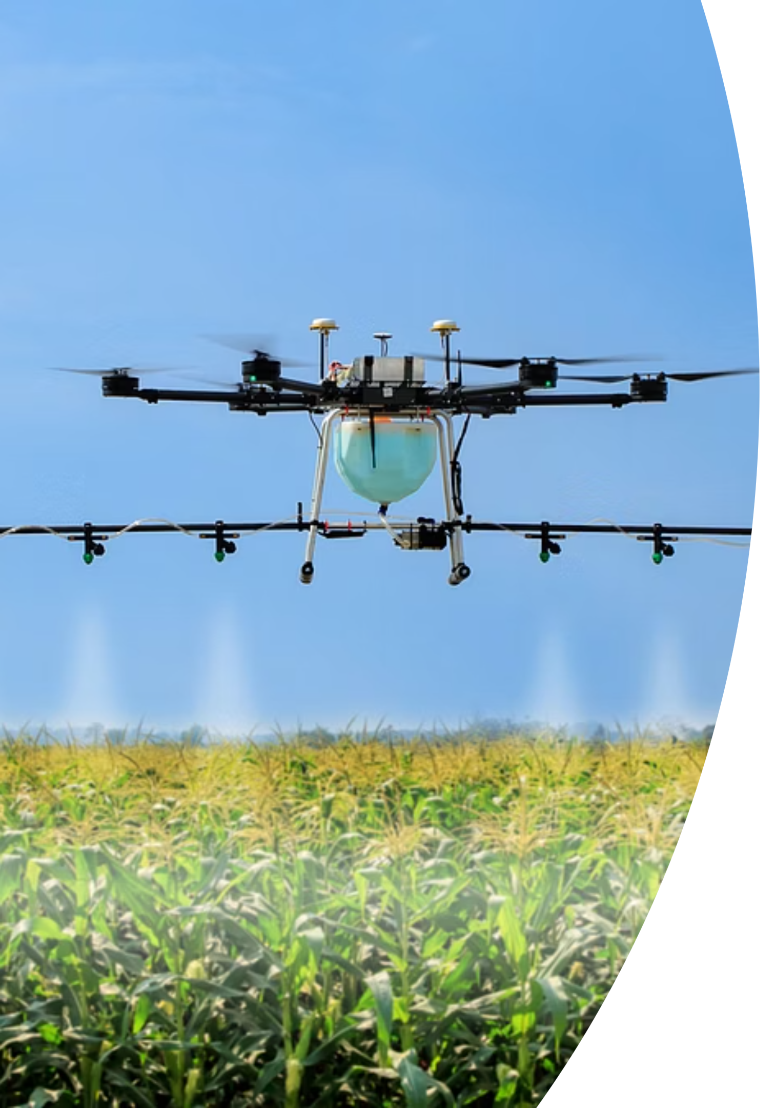
Problem Identification and Proposed Solution
Challenges:
Current systems face challenges such as inaccurate yield prediction, inefficient resource use, and lack of real-time monitoring, leading to suboptimal crop production and increased costs.
Proposed System:
Design a data-driven crop yield prediction system that leverages historical agricultural datasets and applies linear regression algorithms to identify relationships between key factors such as soil type, rainfall, temperature, and irrigation. By analyzing these patterns, the system can forecast crop production and provide farmers with actionable insights for informed decision-making and improved crop management.

Slide 6
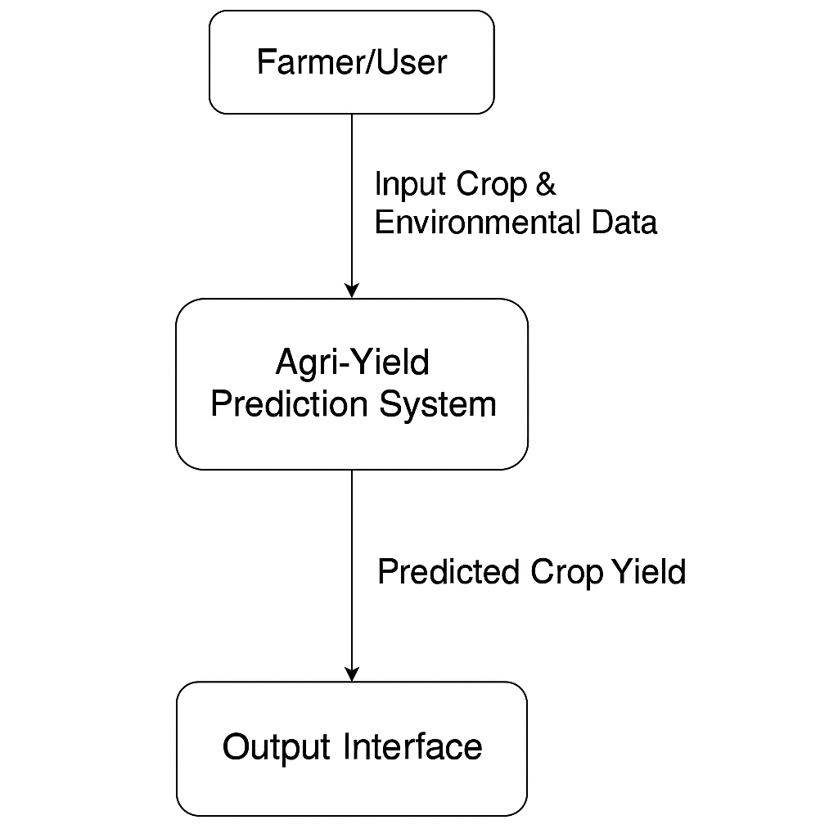
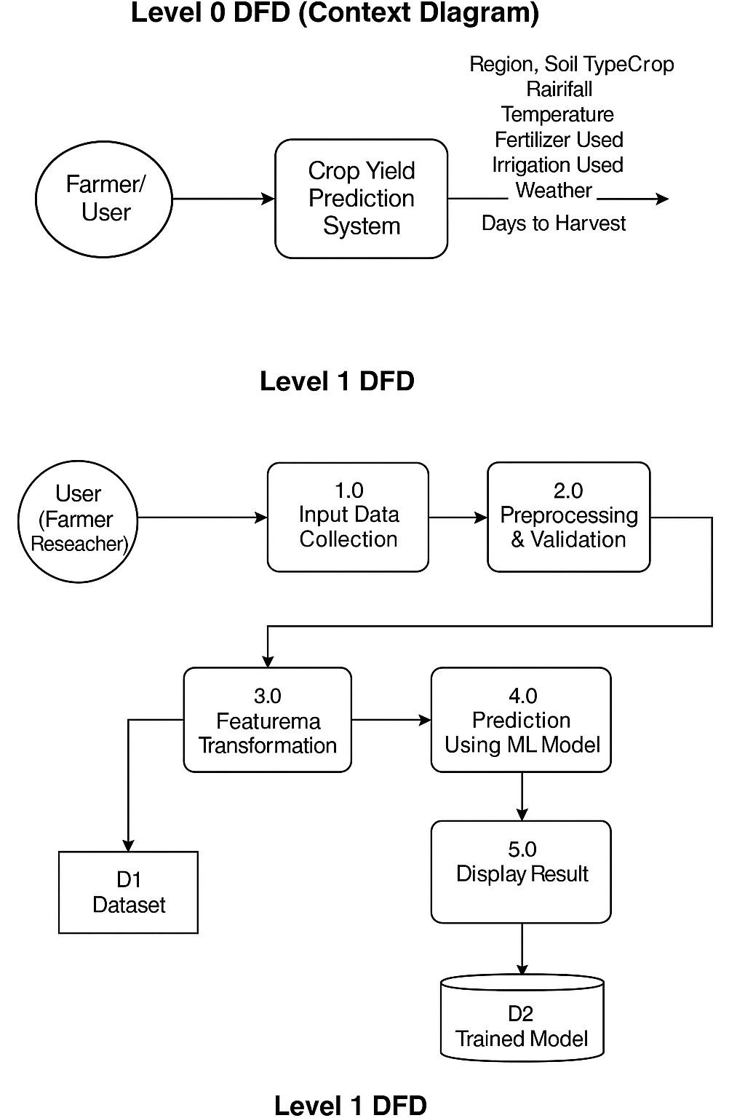
DATA FLOW DIAGRAM:

Slide 7
DATASET TABLE :
Region | Soil_Type | Crop | Rainfall_mm | Temperature_Celsius | Fertilizer_Used | Irrigation_Used | Weather_Condition | Days_to_Harvest | Yield_tons_per_hectare
West | Sandy | Cotton | 897.0772391101236 | 27.676966373377603 | FALSE | TRUE | Cloudy | 122 | 6.555816258223593
South | Clay | Rice | 992.6732816189208 | 18.02614225436302 | TRUE | TRUE | Rainy | 140 | 8.5273409063236
North | Loam | Barley | 147.9980252926104 | 29.79404241557257 | FALSE | FALSE | Sunny | 106 | 1.127443335982929
North | Sandy | Soybean | 986.8663313367325 | 16.64419019137728 | FALSE | TRUE | Rainy | 146 | 6.517572507555278
South | Silt | Wheat | 730.379174445627 | 31.620687370805797 | TRUE | TRUE | Cloudy | 110 | 7.248251218445701
South | Silt | Soybean | 797.4711823962564 | 37.70497446941277 | FALSE | TRUE | Rainy | 74 | 5.898416311841461
West | Clay | Wheat | 357.90235724297685 | 31.59343138976995 | FALSE | FALSE | Rainy | 90 | 2.652391664619867
South | Sandy | Rice | 441.13115357285005 | 30.88710699523619 | TRUE | TRUE | Sunny | 61 | 5.8295423488104605
North | Silt | Wheat | 181.5878606243205 | 26.752728580811905 | TRUE | FALSE | Sunny | 127 | 2.9437164569313867
West | Sandy | Wheat | 395.0489682684721 | 17.646198956255336 | FALSE | TRUE | Rainy | 140 | 3.7072931271974823
North | Peaty | Wheat | 385.13531445805074 | 21.656191734884608 | FALSE | FALSE | Sunny | 73 | 2.564442460083202
East | Sandy | Cotton | 145.3006808203336 | 19.755534985496798 | TRUE | TRUE | Cloudy | 141 | 4.367612094467675
South | Peaty | Cotton | 607.1502520374111 | 15.562163303832799 | TRUE | TRUE | Sunny | 136 | 6.52518615986143
East | Clay | Barley | 929.1237352255479 | 29.677303136616587 | FALSE | TRUE | Rainy | 134 | 6.493030751726615

Slide 8
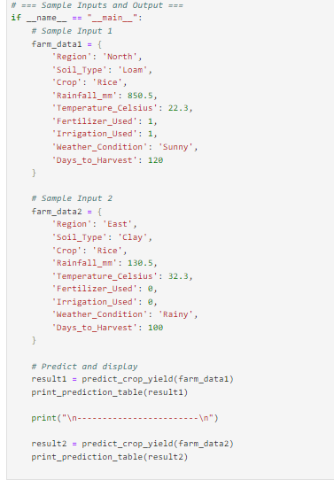
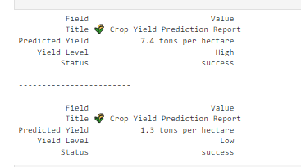
Input & output screen design :

Slide 9
Testing :
Description of how the model was tested
Data split: training vs. testing (e.g., 80:20)
Evaluation metrics used:
Mean Absolute Error (MAE)
Mean Squared Error (MSE)
R² Score
Sample predictions vs. actual crop yields (table or graph)

Slide 10
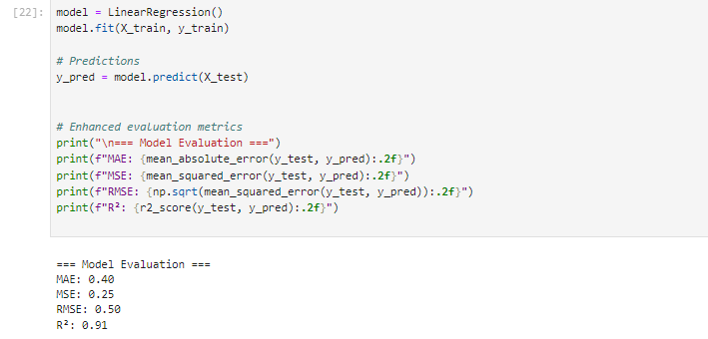
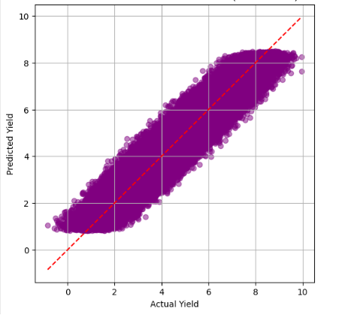
Results :

Slide 11

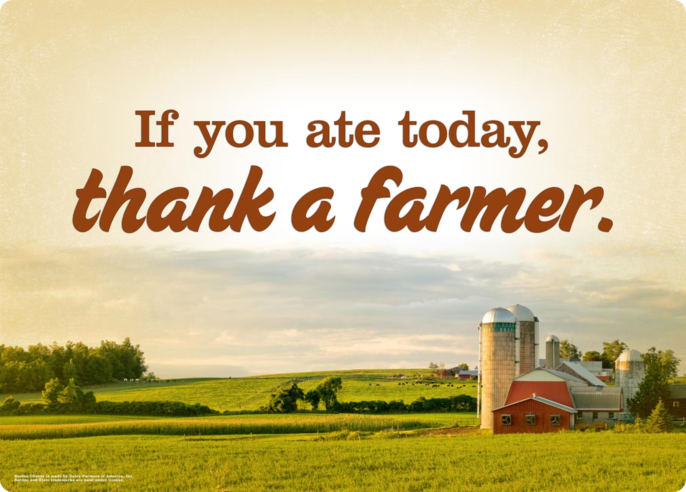
Conclusion :
Farming is crucial for food security and the economy, especially in India. This project, “Agriculture Crop Yield Prediction Using Machine Learning,” helps farmers and researchers predict crop yields accurately. Using Python and machine learning, the system analyzes key factors like soil type, crop type, rainfall, temperature, irrigation, and fertilizer usage.
The results showed that loamy and clay soils with proper irrigation and fertilizer produce the highest yields, with rice and maize performing best under optimal conditions. By leveraging data-driven insights, farmers can make smarter decisions for crop selection, irrigation, and fertilizer management, promoting productive and sustainable farming.

Slide 12
References :
1. Kaggle Agricultural Datasets
Used to collect real-world agricultural data, including rainfall, soil type, temperature, and crop yield, which were essential for training and evaluating machine learning models.
2. Python Machine Learning Documentation
Official documentation for Scikit-learn and Pandas was consulted to guide the development, testing, and optimization of machine learning algorithms.
3. Research Papers on Crop Yield Prediction
Academic and industry research papers provided insights into modern approaches in smart farming, predictive analytics, and crop yield forecasting techniques.
4. W3Schools & MDN Web Docs
Referred for designing the web interface, including HTML, CSS, and JavaScript, ensuring a responsive and user-friendly application.
5. Jupyter Notebook Tutorials
Used extensively for data preprocessing, exploratory data analysis, visualization, and step-by-step implementation of machine learning models.

Slide 13

THANK YOU

